Slide 1
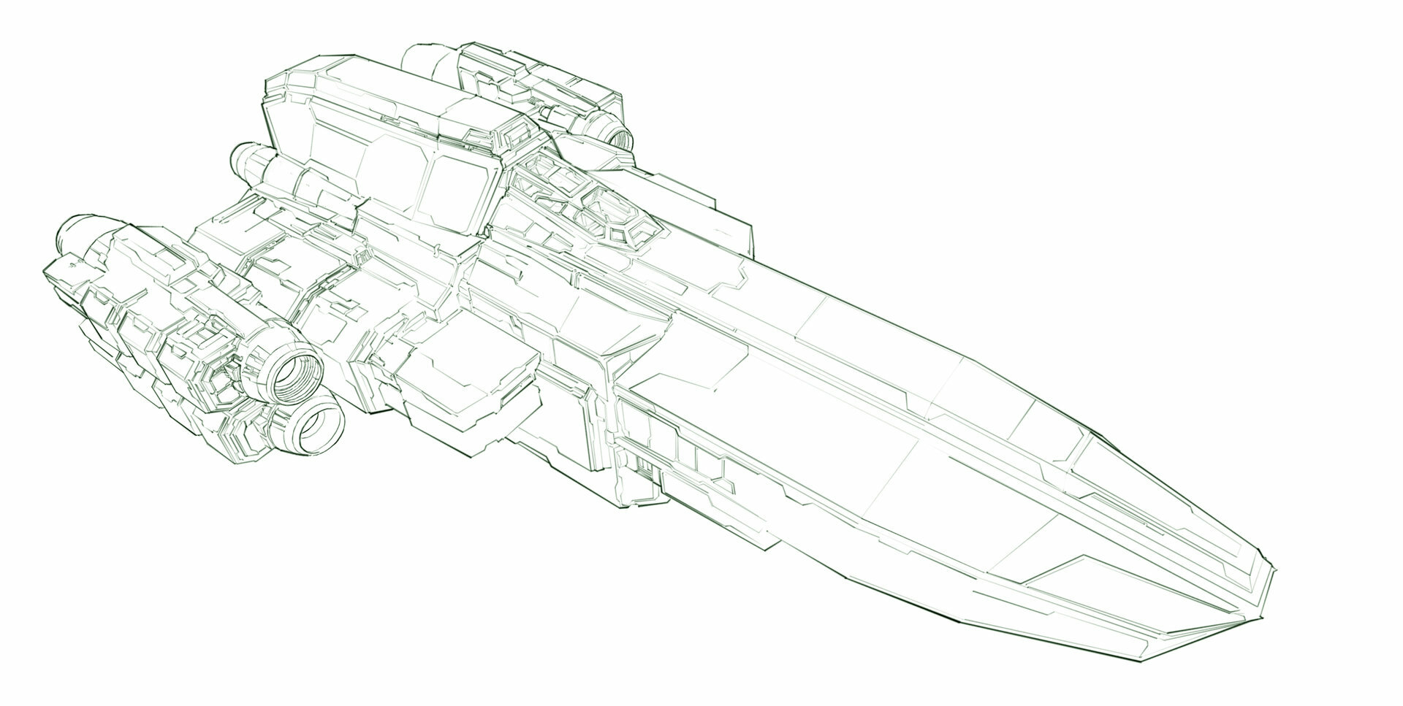
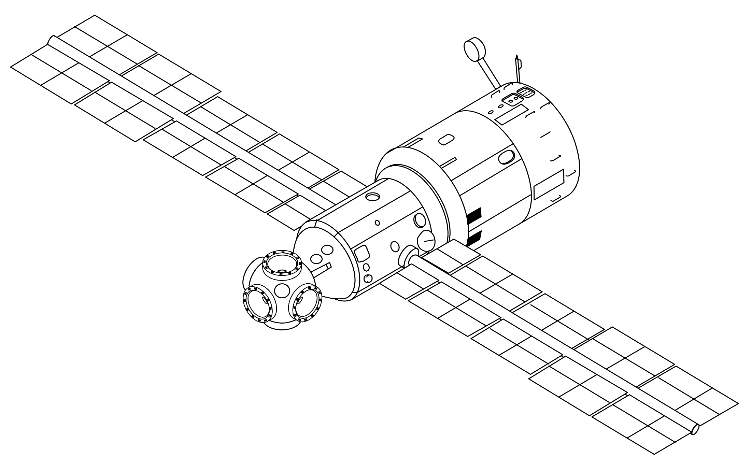
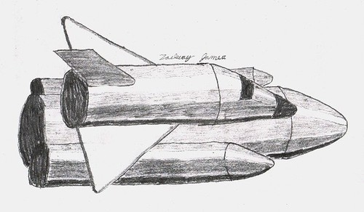
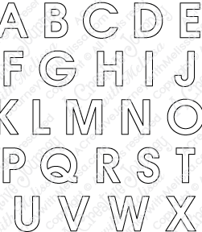
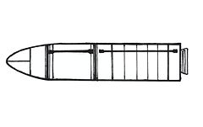

Click here​
Ship will move off from space station.
Ship will fly around planets
Ship will spot enemy
Ship will attack enemy
Enemy will drop letters, ship will collect
Title will be displayed with letters.

